Slide 1
Blue Prism Consolidation Exercise Overview
By: Daniel DeLuca

Slide 2
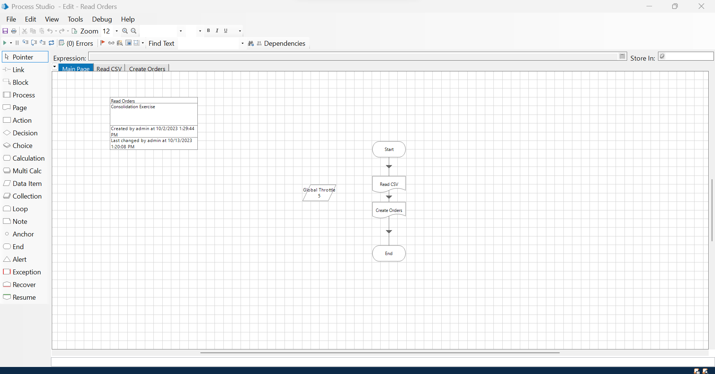
Main Page
The Main page in Process Studio includes page references to the Read CSV page and the Create Orders page

Slide 3
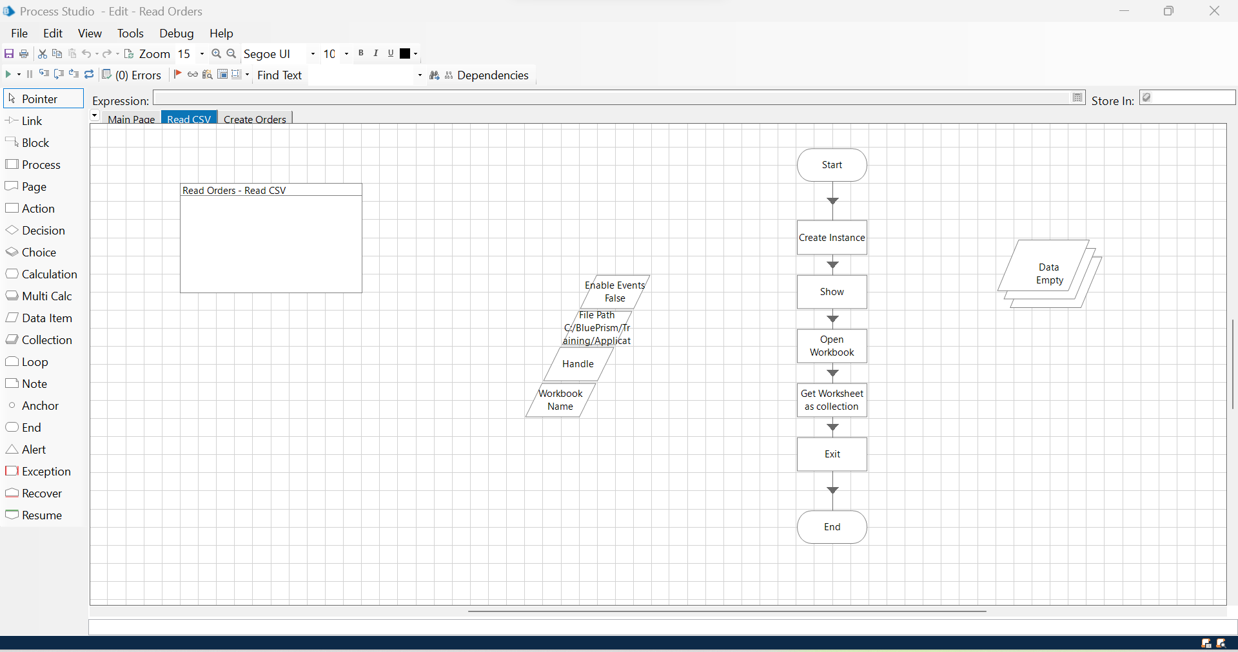
Read CSV
This page opens and then reads the CSV as an input and fills the Data Collection Node with the information from the CSV file

Slide 4
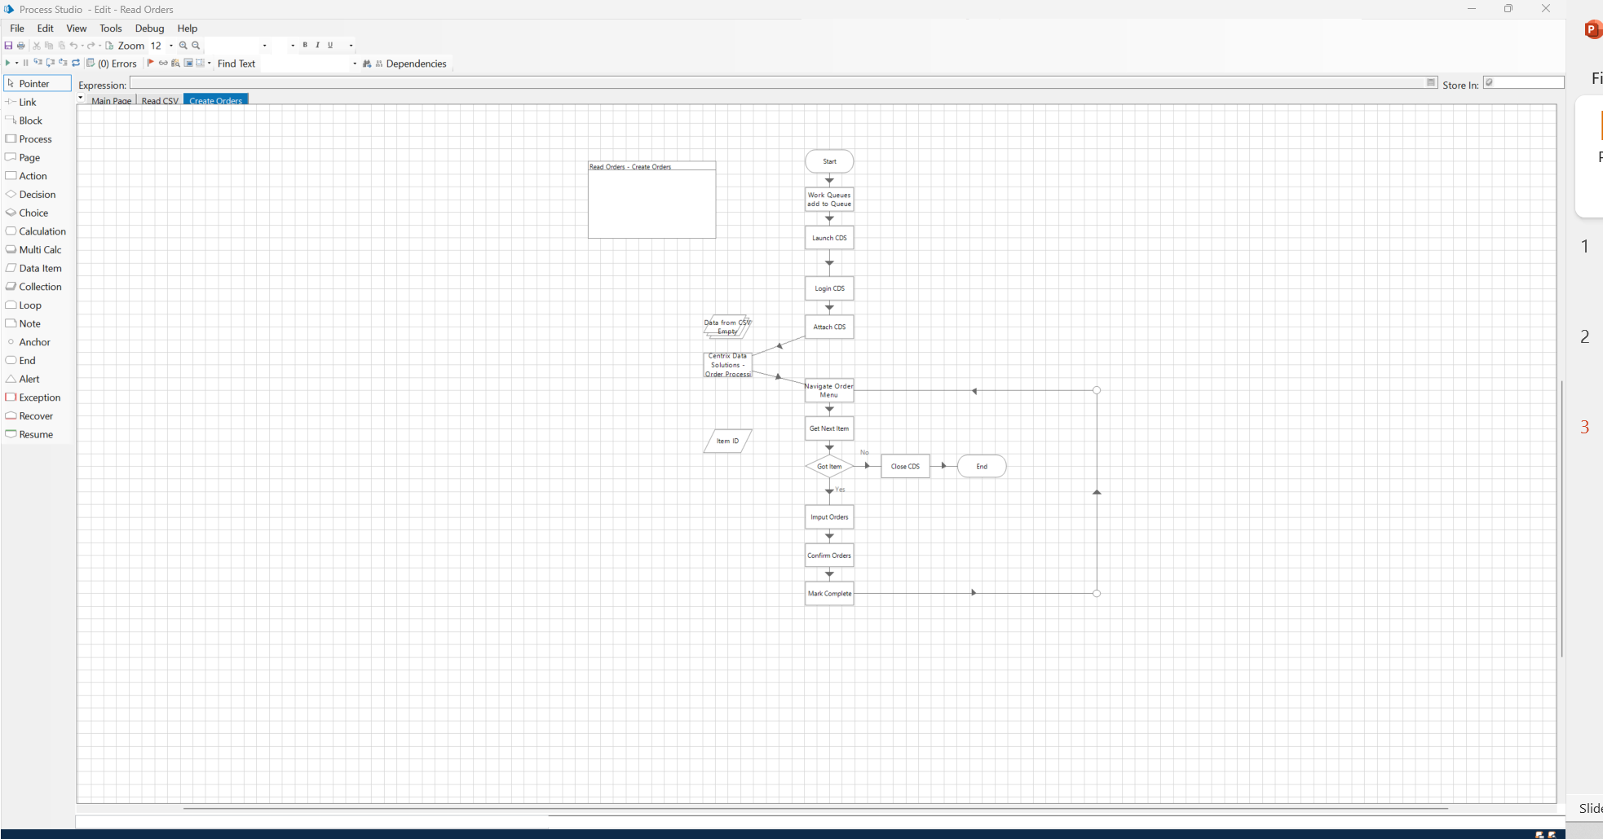
Create Orders
This file is where the bulk of the work takes place
This file is supported by projects in object studio
This file also loads the info from the CSV file into a Work Queue
Explanation to follow

Slide 5

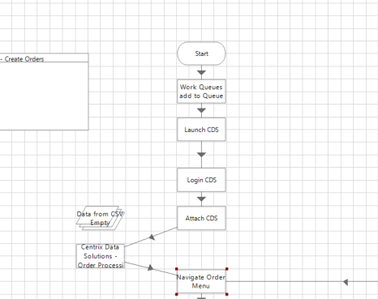
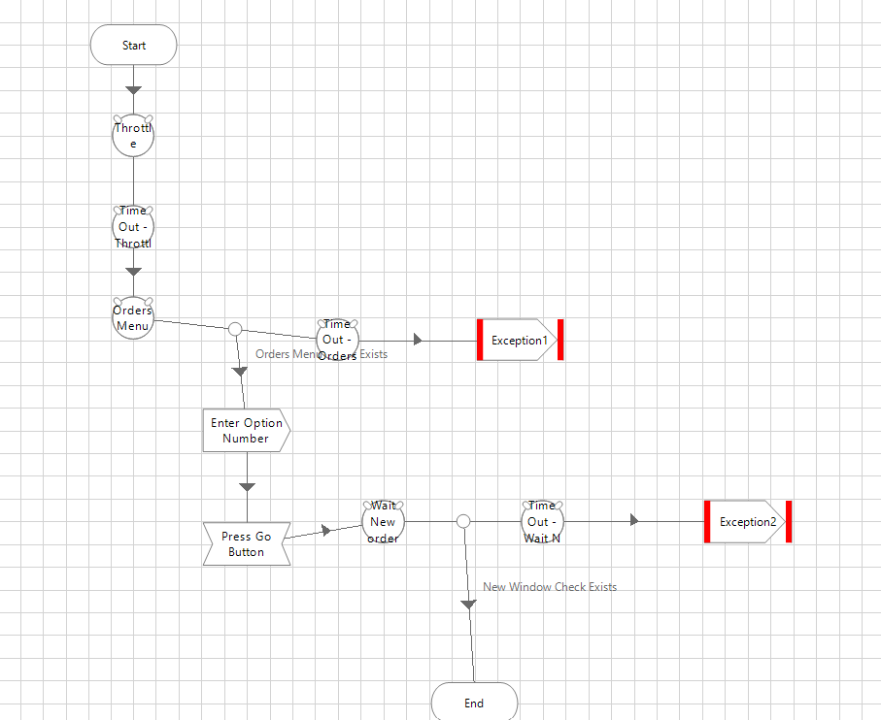
Centrix Data Solutions Process
These two images show the process of logging into Centrix Data solutions and navigating to the correct page for the next step

Slide 6

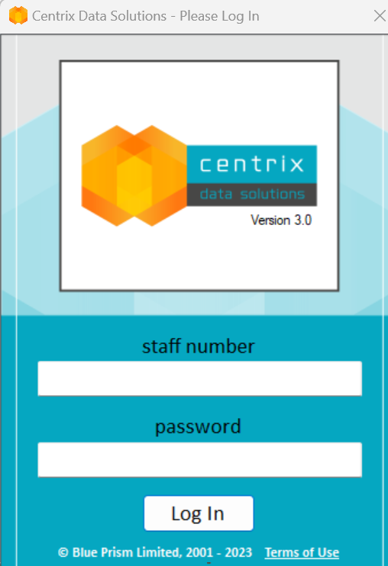
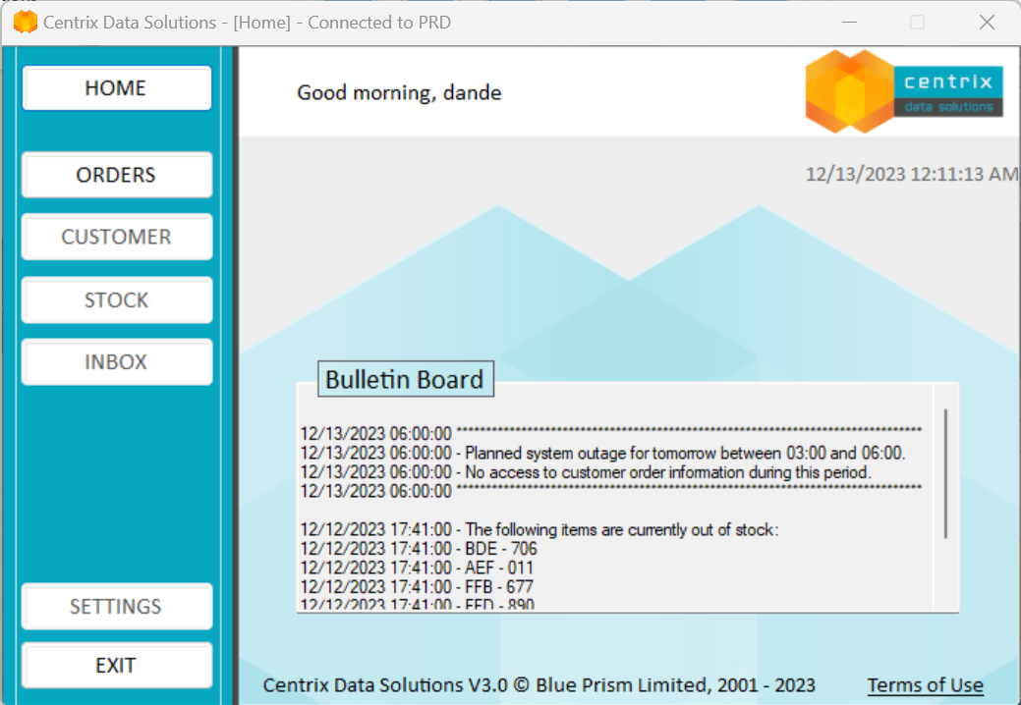
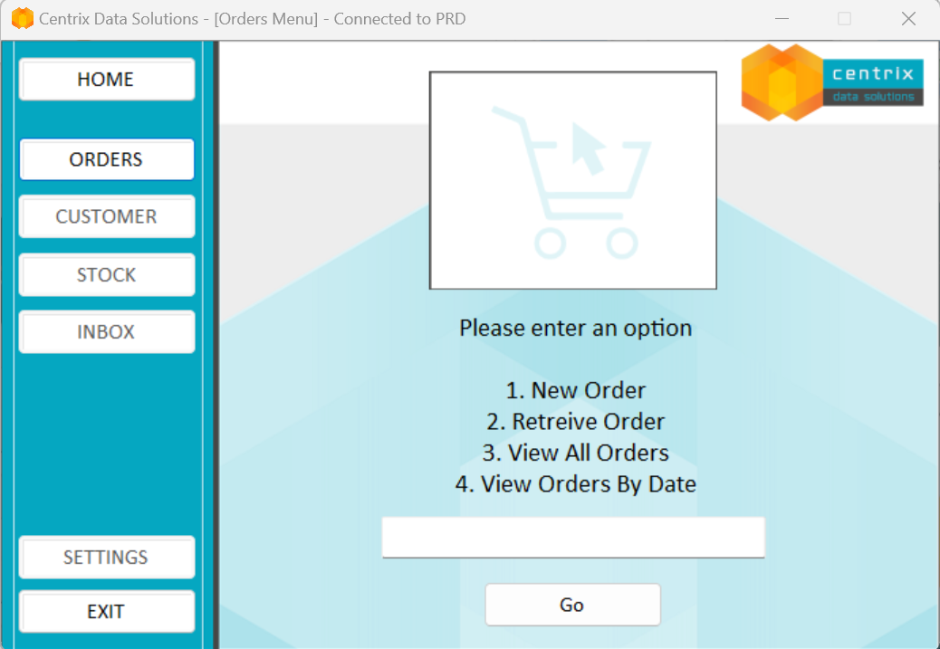
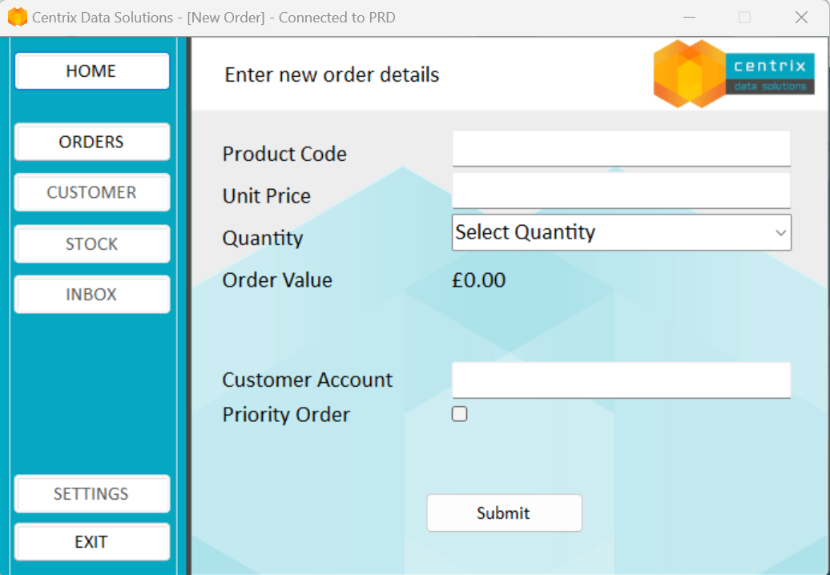



Visual of the Navigation Path Completed

Slide 7
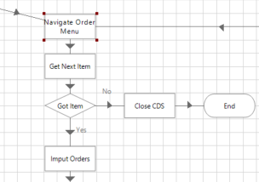
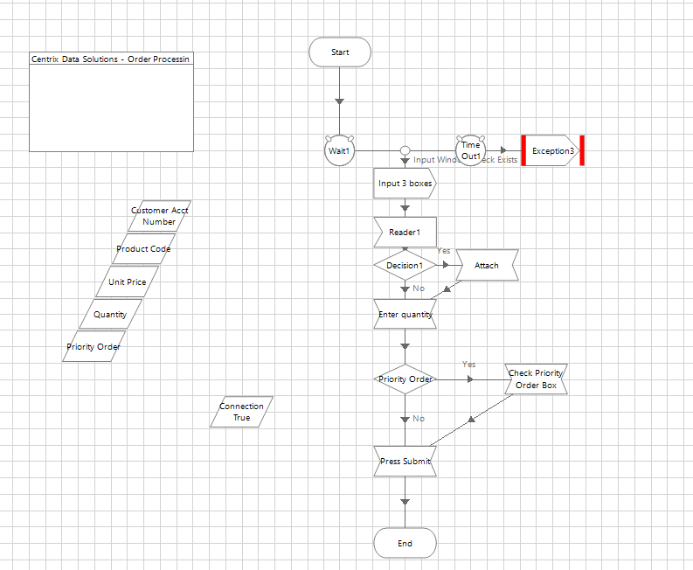
Centrix Data Solutions Process 2
The next step in the process is to get the correct next item from the work queue established previously
If there is no next item then the process will end
Once the next item has been obtained it follows the process in the bottom image
The bottom image shows the process of imputing the correct data into the correct fields.

Slide 8
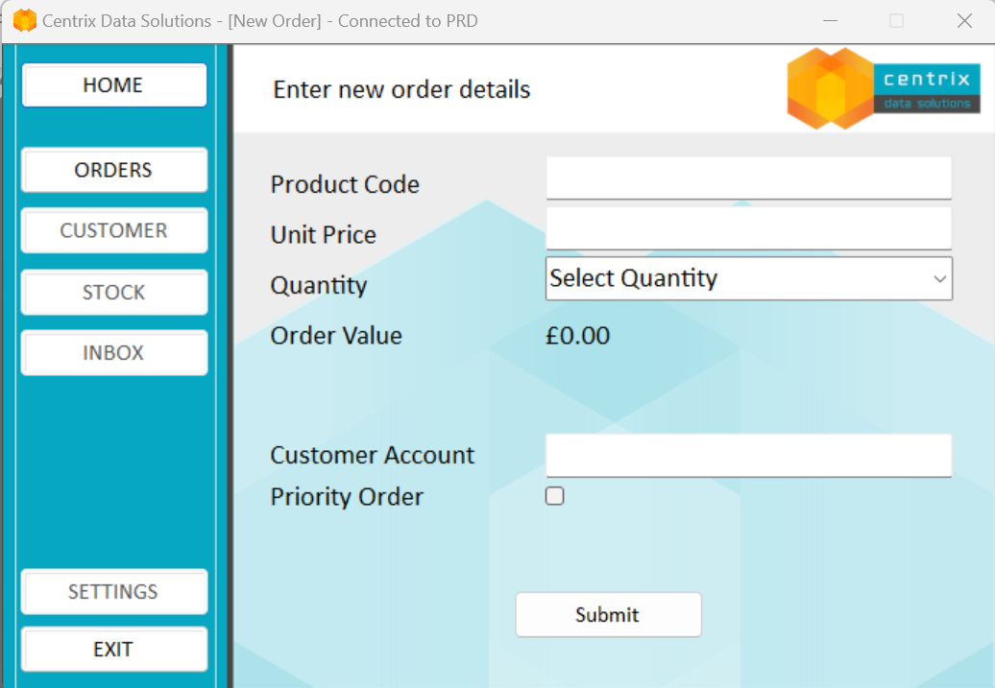
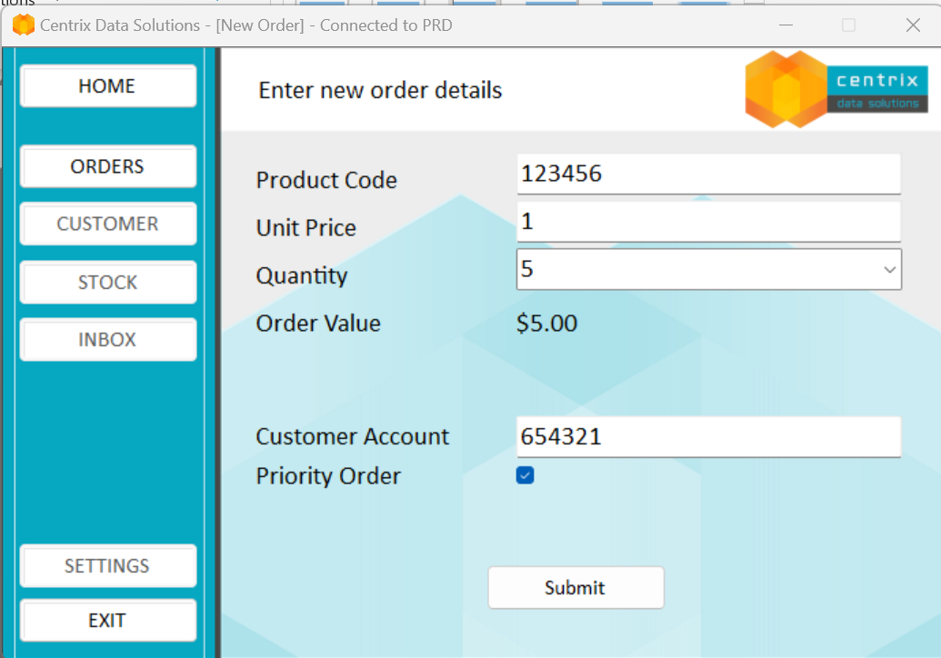
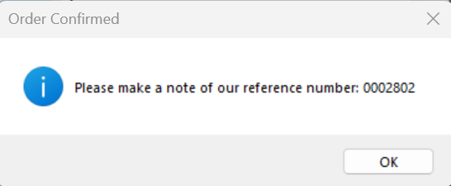
Visual of Process 2

Slide 9
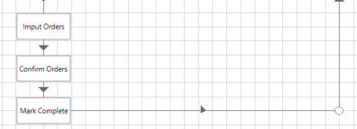
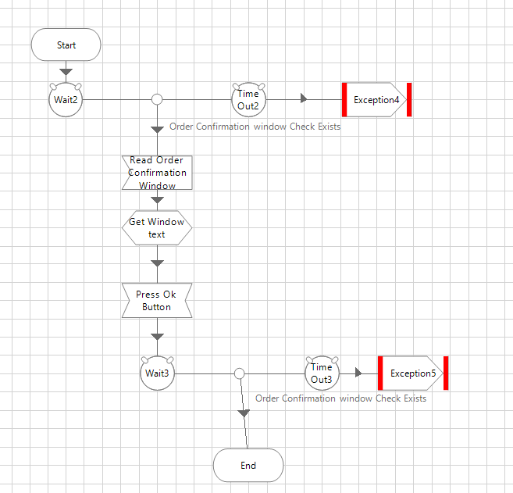
Centrix Data Solutions Process 3
The next step in the process copies the reference number and marks that item in the Work Queue as completed before looping back around to the next item until there are no more items
The process is then finished and closed

